Slide 1
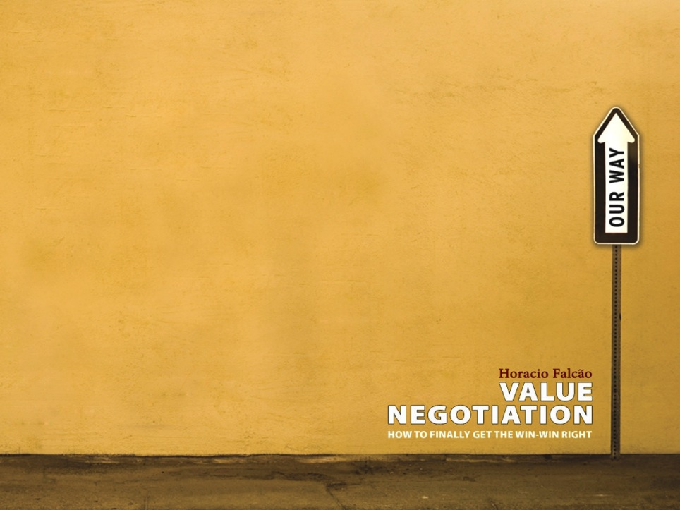




Finding a path forward for LACRALO
A Path to be developed with the entire LACRALO community
e value.negotiation@gmail.com

Slide 2

Dear members of the LACRALO community,
ICANN has asked us to work with the LACRALO community to explore ideas and options to address the serious obstacles that are limiting LACRALO’s effectiveness as a regional at-large organization.
This document provides a brief overview of the mediation process we will be conducting over the coming months.
We look forward to working with you on these important challenges,
Best regards,
Horacio Falcão, Merrick Hoben, Rodrigo Gouveia, David Plumb

Slide 3


Difficult issues and conversations
We recognize that the issues at stake are difficult, many relationships have been damaged and that people are feeling uncomfortable with the situation.
So, we will be asking the LACRALO community to engage in discussions with us about the:
current context
specific frustrations
core underlying concerns
ways in which the community might move forward constructively and practically
At some moments, these conversations may be not so easy.

Slide 4
From different views to a path forward
Our team enters into this effort with no predetermined diagnosis of the issues nor a preferred potential outcome.
We are committed to playing an impartial role in helping the LACRALO community address the challenges it’s facing and co-create possible pathways forward.
To do so, we will start by seeking to understand the full range of views and the underlying issues.

Slide 5
Diagnostic: where will it come from?
Interviews and online survey:
We will be conducting confidential interviews with approximately 15-20 individuals who represent the range of views in the community, as well as sending an online survey to all LACRALO At-Large Structure representatives on the key sets of issues and options that emerge from the interviews.
Diagnostic Report:
The analysis of this information will result in a Diagnostic draft report that summarizes key issues, challenges, and opportunities for moving forward, as well as recommendations for how to design a subsequent in-person engagement.
We will circulate the report inside the community for feedback.

Slide 6
Diagnostic => In-person engagement
After the diagnostic has circulated around the LACRALO community and is well understood and commented, we expect to lead an in-person engagement with members of the LACRALO community (later this year).
(The diagnostic will determine the objectives and methodology for that interaction. In principle, the in-person workshop will seek to develop specific steps that will allow LACRALO to function effectively, as well as a commitment to pursue those steps.)

Slide 7
Timeline and next steps
You can expect the following communication from us over the coming months:
July – We will be reaching out to several of you to conduct interviews. We will also send out the online survey by late July.
August – We will share a draft report and recommend details for an in-person process
Fall / Winter 2016 – We tentatively expect an in-person workshop during the final 3 months of 2016

Slide 8
The mediation team
Our bi-lingual team brings together experienced mediators from two organizations: Value Negotiation (www.valuenegotiation.com) and the Consensus Building Institute (www.cbuilding.org). We have direct experience working with leaders from the Caribbean and Latin America. Short bios are included.
Please feel free to contact us.
Merrick Hoben
mhoben@cbuilding.org

Slide 9
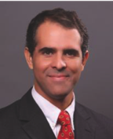
Horacio Falcão
Horacio Falcão is the creator of the Value Negotiation method, founder of Value Negotiation Co. and a Senior Affiliate Professor at INSEAD. At INSEAD he teaches Negotiation, having been voted the Best Elective Professor for nine times in nine years. To his clients, he conducts negotiation and mediation training, coaching, facilitation and consulting to the private and public sectors.
Horacio worked at Cambridge Negotiation Strategies and CMI (a spin-off from the Harvard Negotiation Project) and earlier at two prestigious law firms in Brazil. He has worked for the International Court of Arbitration in Paris and mediated at the courts of Massachusetts. Trained in both civil and common law, Horacio graduated as an LL.M. from Harvard Law School with a concentration on alternative dispute resolution. He received his MBA and his Masters in Organizational Psychology from INSEAD.
Horacio has worked all over the world, mediating complex disputes, facilitating dialogue, developing negotiation & consensus building strategies. He combines this diverse and intense practice with a commitment to keeping himself constantly updated by researching and writing on negotiation. Horacio is an entrepreneur and angel investor with investments in a variety of start-ups all over the world.

Slide 10
Merrick Hoben
Merrick Hoben is Director of the Consensus Building Institute’s Washington, D.C., Regional Office, Practitioner Associate at the MIT-Harvard Public Disputes Program, and Faculty Associate at the Lincoln Institute of Land Policy. Merrick helps stakeholders across diverse organizations and sectors — globally and domestically — to develop and implement more effective agreements.
As leader of CBI's Corporate-Community Engagement practice, he specializes in helping business and its stakeholders/rights holders engage one another more effectively, designing and guiding voluntary standard setting processes, supporting collaborative resource management efforts, and leading complex strategic planning initiatives.
Merrick has extensive experience with mediation, negotiation, and training in Latin America and the Middle East. His bicultural and bilingual Spanish training and mediation experience enable him to work successfully with diverse populations on sensitive resource, human rights and health issues in Latin America and elsewhere.
Merrick is listed on the roster of conflict resolution professionals of the U.S. Institute for Environmental Conflict Resolution. He holds an M.S. in Resource Policy and Public Dispute Resolution from the University of Michigan, and a B.S. in Environmental Science from the University of Vermont. He completed his negotiation and mediation training at the Program on Negotiation at Harvard Law School.

Slide 11
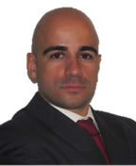

Rodrigo Gouveia
Rodrigo Gouveia is a Senior negotiation consultant at Value Negotiation Co. and, for 2014-2016, an Adjunct Professor at INSEAD (teaching MBAs and Executive Education) and a Visiting lecturer at KFUPM and EDHEC (EMBAs). Rodrigo has taught and consulted in negotiation with clients in Asia, Africa, Europe, Middle East and the Americas. He is the author of several negotiation role-plays and has supported clients in hundreds of negotiations.
Examples of his consulting work are developing negotiation strategies for reimbur-sement of pharmaceutical products, solving judicial conflicts between business owners, improving the negotiation capabilities of procurement divisions, negotia-ting settlements and working with C-level executives in improving their relationships.
Rodrigo was previously a management consultant with Bain & Company. As a consultant, he assisted the top management of a Brazilian financial group in tens of projects, diagnosing and mediating between different companies and business units.
Rodrigo graduated in Genetics and Microbiology and post-graduated in Probability and Statistics at the University of Lisbon. He earned a PhD in Biotechnology from the Technical University of Denmark, where he was a Post-Doctoral researcher. He published 10 scientific articles in international journals.

Slide 12
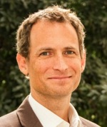
David Plumb
David Plumb is Director of Latin America Practice and Senior Mediator at CBI. As a mediator, facilitator, trainer and researcher, David specializes in consensus building, negotiation, conflict resolution, and designing stakeholder engagement strategies. He directs CBI’s work in Latin America and plays a leadership role in CBI’s Corporate Stakeholder Engagement practice.
David has experience managing complex disputes and public policy issues in the U.S., Africa, Latin America, and Europe.
Before, David was director of the Sustainable Business Practice at Search for Common Ground, a world leader in conflict resolution. The practice assisted corporations and their stakeholders to find common ground and create sustainable relationships. He was also a financial journalist and correspondent. A bilingual Spanish speaker, David has spent about half of the past 18 years living and working in developing countries.
A Fulbright Scholar, David holds a Masters in Public Administration from Harvard University’s Kennedy School of Government and a BA in Politics and Latin American Studies from Princeton University.

Slide 13
Finding a path forward for LACRALO
A Path developed with the entire LACRALO community
e value.negotiation@gmail.com

