Slide 1
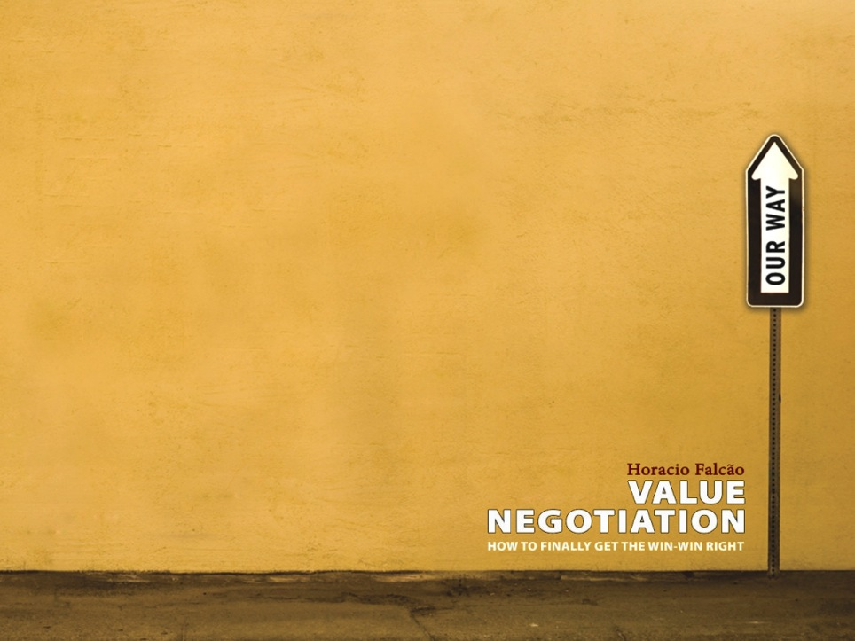




Encontrando un camino hacia adelante para LACRALO
Un camino para desarrollar en conjunto con toda la comunidad lacralo
e value.negotiation@gmail.com

Slide 2

Estimados integrantes de la comunidad LACRALO,
ICANN nos ha pedido trabajar con la comunidad LACRALO para explorar ideas y opciones para abordar los serios obstaculos que están limitando la efectividad de LACRALO como una organización regional “at-large’.
Este documento oferece un breve resumen del proceso de mediación que vamos a conducir durante los próximos meses.
Será un privilegio trabajar con ustedes en estos importantes desafíos.
Saludos cordiales,
Horacio Falcão, Merrick Hoben, Rodrigo Gouveia, David Plumb

Slide 3


Temas y conversaciones difíciles
Reconocemos que los temas en juego son difíciles, muchas relaciones han sido dañadas y mucha gente se siente incómoda con la situación.
Por lo tanto, vamos a pedir a la comunidad LACRALO que converse con nosotros sobre:
El contexto actual
Sus frustraciones específicas
Sus preocupaciones fundamentales
Las maneras en las que la comunidad pueda avanzar en forma constructiva y concreta
En algunos momentos, estas conversaciones no serán tan fáciles.

Slide 4
De miradas diferentes a un camino adelante
Nuestro equipo entra en este proceso sin un diagnóstico pre-determinado, y sin inclinarse hacia un resultado.
Nos comprometemos a jugar un rol imparcial para ayudar a la comunidad LACRALO a abordar los desafíos que se enfrenten y co-crear posibles caminos hacia adelante.
Para hacer esto, partiremos intentando entender la gama completa de perspectivas y temas fundamentales.

Slide 5
Diagnóstico: De dónde vendrá?
Entrevistas y encuesta en línea:
Realizaremos aproximadamente 15-20 entrevistas confidenciales con individuos que representen el rango de perspectivas dentro de la comunidad, además de una encuesta con todos los representantes de la estructura “at-large” LACRALO, enfocada en los temas claves y las opciones que emerjan de las entrevistas.
Informe diagnóstico:
El análisis de esta información se plasmará en un informe diagnóstico que resumirá los temas claves, los desafíos, y las oportunidades para avanzar, junto con recomendaciones para diseñar un taller presencial mas adelante.
Distribuiremos un borrador del informe dentro de la comunidad para recibir retroalimentación.

Slide 6
Diagnóstico => Taller Presencial
Una vez que el diagnóstico haya sido compartido, entendido y comentado dentro de la comunidad LACRALO, esperamos liderar este año un taller presencial con integrantes de la comunidad.
(El diagnóstico determinará los objetivos y metodología de esta interacción presencial. En principio, el taller buscará desarrollar paso concretos que permitirían a LACRALO funcionar eficazmente, y un compromiso para seguir esos pasos. )

Slide 7
Línea de tiempo y próximos pasos
Durante los próximos meses pueden esperar la siguiente comunicación de nosotros :
Julio – Contactaremos a varios de ustedes para realizar entrevistas. También mandaremos la encuesta hacia el fin de mes.
Agosto – Compartiremos un borrador del informe y recomendaciones para un proceso presencial.
Fines de 2016 – Tentativamente esperamos realizar un taller presencial en los últimos 3 meses de 2016.

Slide 8
El equipo de mediación
Nuestro equipo es bilingüe y reúne mediadores profesionales de dos organizaciones: Value Negotiation (www.valuenegotiation.com) y Consensus Building Institute (www.cbuilding.org). Tenemos experiencia en trabajar en el Caribe y América Latina. Se adjunta biografías cortas.
Por favor no duden en contactarnos.
Merrick Hoben
mhoben@cbuilding.org

Slide 9
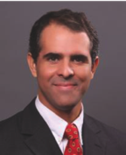
Horacio Falcão
Horacio Falcão is the creator of the Value Negotiation method, founder of Value Negotiation Co. and a Senior Affiliate Professor at INSEAD. At INSEAD he teaches Negotiation, having been voted the Best Elective Professor for nine times in nine years. To his clients, he conducts negotiation and mediation training, coaching, facilitation and consulting to the private and public sectors.
Horacio worked at Cambridge Negotiation Strategies and CMI (a spin-off from the Harvard Negotiation Project) and earlier at two prestigious law firms in Brazil. He has worked for the International Court of Arbitration in Paris and mediated at the courts of Massachusetts. Trained in both civil and common law, Horacio graduated as an LL.M. from Harvard Law School with a concentration on alternative dispute resolution. He received his MBA and his Masters in Organizational Psychology from INSEAD.
Horacio has worked all over the world, mediating complex disputes, facilitating dialogue, developing negotiation & consensus building strategies. He combines this diverse and intense practice with a commitment to keeping himself constantly updated by researching and writing on negotiation. Horacio is an entrepreneur and angel investor with investments in a variety of start-ups all over the world.

Slide 10
Merrick Hoben
Merrick Hoben is Director of the Consensus Building Institute’s Washington, D.C., Regional Office, Practitioner Associate at the MIT-Harvard Public Disputes Program, and Faculty Associate at the Lincoln Institute of Land Policy. Merrick helps stakeholders across diverse organizations and sectors — globally and domestically — to develop and implement more effective agreements.
As leader of CBI's Corporate-Community Engagement practice, he specializes in helping business and its stakeholders/rights holders engage one another more effectively, designing and guiding voluntary standard setting processes, supporting collaborative resource management efforts, and leading complex strategic planning initiatives.
Merrick has extensive experience with mediation, negotiation, and training in Latin America and the Middle East. His bicultural and bilingual Spanish training and mediation experience enable him to work successfully with diverse populations on sensitive resource, human rights and health issues in Latin America and elsewhere.
Merrick is listed on the roster of conflict resolution professionals of the U.S. Institute for Environmental Conflict Resolution. He holds an M.S. in Resource Policy and Public Dispute Resolution from the University of Michigan, and a B.S. in Environmental Science from the University of Vermont. He completed his negotiation and mediation training at the Program on Negotiation at Harvard Law School.

Slide 11
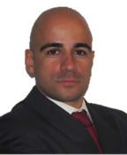

Rodrigo Gouveia
Rodrigo Gouveia is a Senior negotiation consultant at Value Negotiation Co. and, for 2014-2016, an Adjunct Professor at INSEAD (teaching MBAs and Executive Education) and a Visiting lecturer at KFUPM and EDHEC (EMBAs). Rodrigo has taught and consulted in negotiation with clients in Asia, Africa, Europe, Middle East and the Americas. He is the author of several negotiation role-plays and has supported clients in hundreds of negotiations.
Examples of his consulting work are developing negotiation strategies for reimbur-sement of pharmaceutical products, solving judicial conflicts between business owners, improving the negotiation capabilities of procurement divisions, negotia-ting settlements and working with C-level executives in improving their relationships.
Rodrigo was previously a management consultant with Bain & Company. As a consultant, he assisted the top management of a Brazilian financial group in tens of projects, diagnosing and mediating between different companies and business units.
Rodrigo graduated in Genetics and Microbiology and post-graduated in Probability and Statistics at the University of Lisbon. He earned a PhD in Biotechnology from the Technical University of Denmark, where he was a Post-Doctoral researcher. He published 10 scientific articles in international journals.

Slide 12
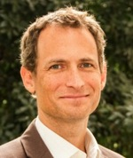
David Plumb
David Plumb is Director of Latin America Practice and Senior Mediator at CBI. As a mediator, facilitator, trainer and researcher, David specializes in consensus building, negotiation, conflict resolution, and designing stakeholder engagement strategies. He directs CBI’s work in Latin America and plays a leadership role in CBI’s Corporate Stakeholder Engagement practice.
David has experience managing complex disputes and public policy issues in the U.S., Africa, Latin America, and Europe.
Before, David was director of the Sustainable Business Practice at Search for Common Ground, a world leader in conflict resolution. The practice assisted corporations and their stakeholders to find common ground and create sustainable relationships. He was also a financial journalist and correspondent. A bilingual Spanish speaker, David has spent about half of the past 18 years living and working in developing countries.
A Fulbright Scholar, David holds a Masters in Public Administration from Harvard University’s Kennedy School of Government and a BA in Politics and Latin American Studies from Princeton University.

Slide 13
Encontrando un camino hacia adelante para LACRALO
Un camino para desarrollar en conjunto con toda la comunidad lacralo
e value.negotiation@gmail.com

