Slide 1

LACRALO Mediation Process – Second Meeting
March 14 & 15, 2018
San Jose, Puerto Rico
MEETING SUMMARY
DRAFT

Slide 2

Overview
LACRALO members met in San Juan, Puerto Rico for two days in March to continue a mediation process aimed at helping LACRALO function more effectively as a regional At-Large organization. The purpose of the meeting was to:
Take stock of the progress on the 2017 commitments. Where has LACRALO progressed the most since the first meeting a year ago? What issues need more attention?
Discuss and agree on concrete governance proposals. Building on the outputs of the Governance Working Group during the past 12 months, what recommendations and next steps do participants want to make to the full LACRALO community to update operating principals, metrics, voting procedures and related issues?
Participants achieved those goals and also developed a clearer statement around LACRALO’s common purpose.
This document is a summary of the conversations and agreements reached among participants in the meeting (a list of participants is included at the end). Participants concluded the meeting defining the steps ahead to finish this mediation process and engage the rest of the LACRALO network in it.

Slide 3
KEY AGREEMENTS

Slide 4
Taking stock of the past year
Main takeaways from a “scorecard” exercise:
The positives:
There has been progress. Draft governance documents were produced. Initiatives were undertaken
There has been more respectful interaction, less confrontation
There has been an increase in participation in activities such as the monthly calls.
The frustrating aspects:
There hasn’t been enough communication on multiple levels: inside the network about the mediation process and its progress; among LACRALO leadership, ALAC members and the network on policy; network members aren’t providing input on draft documents; etc.
The draft documents need adjustments
Process feels slow (not to everyone)
We still don’t have a common purpose. We don’t have a common strategy about what we should actually be doing (particularly relevant around how LACRALO should be influencing ICANN policy).

Slide 5
A Common Purpose for LACRALO
The scorecard exercise prompted the group to spend time developing the components of a common purpose, based around LACRALO’s existing mission as described in its MOU with ICANN.
Once defined, the group used this common purpose to judge governance options that would help LACRALO fulfill its mission, vision, and priority actions.

Slide 6
Our Common Purpose
WHY? A VISION FOR WHY THIS MATTERS
HOW? WHAT ARE WE DOING TO ACHIEVE OUR MISSION AND VISION
LACRALO’S MISSION
LACRALO’s mission is to contribute to the development of ICANN policies from the perspective of end users. Its area of action is ICANN’s At-Large community.
LACRALO envisions an Internet community in which the unique perspectives and interests of Latin American and Caribbean end users are put on the table and taken into consideration in the development of ICANN policies, with a particular emphasis in ensuring end users are aware of their Internet-related rights, and enjoy affordable, stable and secure access to internet services and benefits. LACRALO works at the intersection of these interests and ICANN’s remit
LACRALO is a conduit for relevant two-way communication.
OUTREACH, “IN-REACH” & CAPACITY BUILDING - is essential to push information out, create the conditions for informed participation, and keep people motivated/excited.
PARTICIPATION AND ENGAGEMENT: There are multiple channels for LACRALO to have influence on ICANN policies – individual participation in different WGs and PDPs, working with ALAC representatives, establishing LACRALO statements, other ways.
PRIORITIZATION is key to focus and having impact

Slide 7
ELEMENTS OF GOVERNANCE

Slide 8
What leadership team does LACRALO need?
Principles: We seek strong coordination among all LACRALO leaders and representatives. We seek opportunities for multiple people to get involved and share workload
In light of these principles:
Broad agreement on creating a board
  To coordinate better LACRALO’s efforts around policy and outreach, ie, LACRALO’s strategy.
  Composed of all the elected/selected LACRALO representatives and leaders, so that they have a single interface to coordinate better. (Chair, secretary, vice-chair, vice-secretary, 2 elected ALAC members, 3rd ALAC member, nomcom, & heads of working groups.)
  Provides opportunity for more members to be directly involved in LACRALO work.
Suggestion to change proposed “vice-chair” position into a “chair-elect” position.
  Under a chair-elect approach (typical in many organizations), the chair-elect spends 2 years gaining experience then automatically becomes the chair. Under this system, you only select the chair-elect, who has a four-year cycle (2 years learning, two years as chair). You use a recall function if the chair-elect turns out to be a dud. ”Secretary-elect” position would function the same way.
  Group was intrigued with this idea, but didn’t reach consensus. In addition, at least one participant did not agree with the idea of a vice-chair and vice-secretary position (he preferred adding a third member to the leadership team).
Need to clarify roles and terminology around “secretary” position
  Should clearly define terminology and roles for secretary versus ICANN staff. Recognize and resolve confusion between ”secretary” and “secretariat”

Slide 9
How should we select leaders?
Principles: We want a system that has:
  Rotation among countries/regions and opportunities for new faces
  Continuity and opportunities for learning from experienced leaders
  Simplicity
  A “consensus-based” approach
  Incentives for active participation
Given these principles, there was broad support for creating a new system of rotating leadership positions among four sub-regions in LACRALO.
Under this system, each sub-region would always have someone in one of the elected positions (chair, secretary, 2 ALAC members (Nomcom could get included in this too)).
For example, if it was the turn of sub-region A to hold the chair position, the sub-region would put forward candidates and the entire LACRALO would vote. In the subsequent election, sub-region A would put forward candidates for different position, defined under the rotation.
In the event a sub-region didn’t have candidates that year meeting minimum criteria, the position would shift to the next sub-region.

Slide 10
How should we select leaders? (2)
The proposed four sub-regions
Mexico & Central America
MX, Hon, Pan, El Sal, Nic, CR
(Currently has 8 ALSs)
Caribbean
Hait, Cuba, DR, Fr. Guyana, Suri, T&T, GR, BD, St.L, St.V, Ant, St.K, Jam, Belize, Bah
(Currently has 11 ALSs)
Andean
Vz, Pe, Co, Ch, Ecu, Bol
(Currently has 16 ALSs)
Mercosur
Br, Ar, Uru, Para
(Currently has 19 ALSs)
2-year terms for all positions. To promote continuity, either stagger chair and secretary elections (one year chair election, next year secretary) , or use the new proposed system of a “chair-elect” and choose chair-elect and secretary-elect in the same same year)
No consecutive terms in the same position, and no more than 2 terms total per individual (still some doubts around this last piece, however there is a consensus that we should be constantly seeks new faces)

Slide 11
How should we select leaders (3)
Eligibility requirements for holding leadership positions
ALSs versus individual members
  For Chair and Secretary – Representative of an ALS in “good standing”
  For ALAC – ALSs in good standing and individual members (very close to consensus on this point – see later slide on individual membership)
ALSs in “good standing” means activing participating ALSs as defined by metrics
Should take a broad definition of active participation
  Look at all the ways the person and the ALS are participating in ICANN-related activities, through LACRALO or in other channels.
  There are many ways to show participation in ICANN-related activities, ranging from presentations to events and social media activity.
  Should be aligned with the “LACRALO Common Purpose” framework
Candidates should provide a Statement of Interest covering basic criteria for leadership (similar to other at-large elected positions and NomCom)

Slide 12
How should leaders demonstrate performance and be held accountable?
The board as a whole should report on its activities and results in line with the elements of LACRALO’s Common Purpose.
  What has been done in outreach, “in-reach” to existing members and capacity building
  What has been done to influence ICANN policies
  What priorities have been set in terms of key issues & strategies
Individual board members should also show some basic metrics around their contributions and activity.
  While participation in conference calls is one potential metric, let’s try to think more broadly about actual contributions.

Slide 13
Metrics for ALS activity
Principle: We want to encourage active participation among ALSs, and provide an incentive for this activity
Given this, there is broad support for metrics that look at the activity of the ALS in contributing to LACRALO’s Common Purpose
Metrics should include multiple ways in which ALSs contribute directly through LACRALO events and through other ICANN channels
The activities of all ALS members count towards the ALS’s metrics
The draft metrics document is a good starting place
The idea is NOT to create metrics for decertification, but rather have a way to reach out to inactive ALSs to understand better their inactivity, and have metrics for a new category of “active” ALSs, that have the right to vote and field candidates

Slide 14
Individual membership
Principles: LACRALO wants to encourage broad participation. It also recognizes the value that ALSs provide in representing interests.
Given these principles, there was broad support for allowing individual end users to participate in all LACRALO activities, including chairing working groups (which means they could be members of the board).
We should define a model for this participation, for example a “virtual?” organization of individual users, as in other RALOs.
We need to update LACRALO documents immediately (next 2 months) to respond to a requirement coming out of the ALAC review, in which LACRALO is the only non-compliant RALO. This can be done even before resolving the pending issue of which (if any) elected positions individual members might hold.
The group came very close to an agreement about individual members and elected positions. There was very broad support (but not full consensus) on:
  Individual members can chair working groups, and be elected to the ALAC
  But not be elected to Chair or Secretary of LACRALO (but they still could form part of the board if they chaired a working group)

Slide 15
Dispute resolution process
Principle: LACRALO seeks to resolve disputes through consensus-based processes, yet also has a final decision-making step if all consensus-based options are exhausted. Also, the process needs to be cost-efficient and use existing resources.
With this mindset, the group agree on a three-step process:
  Attempt resolution inside LACRALO, with the board and relevant working groups providing information and advice to the parties to find a solution (perhaps Emeritus Council provides advice).
  ICANN Ombudsman: Use the ICANN ombudsman to have a structured process with an independent party (the ombudsman) to explore a potential resolution. The ombudsman doesn’t have decision-making authority, only helps parties explore options.
  Final decision-making step: If all the previous avenues don’t work, the group proposed a process in which three well-regarded experts in the ICANN orbit are selected to review the issues and provide a final opinion. The experts would volunteer their time. (The group didn’t discuss how to select the experts.)

Slide 16
Emeritus Council
Primary focus should be on mentoring, orientation and onboarding new members and new leaders
Revise current draft to better reflect that
There may be some role in advising on LACRALO disputes, but we now have a separate dispute resolution plan

Slide 17
Pending points without agreement
Country co-efficient
With the new, proposed rotating voting system to select leadership, there were different opinions around whether to maintain the country-coefficient calculation that creates a system of “one country, one vote”
There are two different views about whether this system is “fair”. For some, it is essential to maintain an “equitable” approach that doesn’t let big countries dominate. In this view, the rotation system is a separate issue from this “equitable” principle. For others, it goes against the idea that LACRALO is made up of ALSs, and those ALSs should select leaders and make decisions. In this second point of view, LACRALO can achieve a sense of equity through the rotating sub-regions, restrict voting to active ALSs, and be explicit about the intent of rotating positions among countries even inside of the sub-regions.
Participants agreed to run some voting simulations to have more information to make a decision.
Individual membership eligibility to hold positions
As mentioned previously, there was very broad support (but not full consensus) on:
  Individual members can chair working groups, and be elected to the ALAC
  But not be elected to Chair or Secretary of LACRALO (but they still could form part of the board if they chaired a working group)

Slide 18
NEXT STEPS

Slide 19
Key challenges looking ahead
How do we explain ourselves clearly, and help other LACRALO members go through the thought process we just had?
How do we finish the work?
How do we interest / entice people in the purpose and work of LACRALO?

Slide 20
Next Steps
WHAT | WHO and WHEN
Write and send draft meeting summary to participants, then share final version with LACRALO | David prepares English and Spanish versions within days, gives participants a week to comment, then Humberto sends final version to full listserve
Share meeting outcomes with colleagues and network, once Humberto circulates summary on listserve. | Everyone reaches out this month to colleagues and creates opportunities to share meeting results
Adopt new agreed approach on individual members. Put on wiki, webinar, vote and adopt | Humberto – gets translation ASAP. Schedule a webinar. Vote before 15-mayo.
Adapt existing Operating Principles document. Includes creating “roadmap” of calls on key issues. Once we have a new draft, put on wiki for everyone to see. Comment period. Call a vote that ratifies it. | Governance WG – Starts now in March. Deadline for new version in June. Complete vote and ratification in July
Metrics – revise based on this meeting | Alberto Soto – within a month
Emeritus Council – update to reflect conversation | Sylvia and WG completes by April.
Rules of procedure. Once ready, put on wiki for longer comment period. Then make a clean draft and new period to review and adopt | Governance WG – expect to finalize a clean draft by July this year. Get a vote by Barcelona meeting

Slide 21
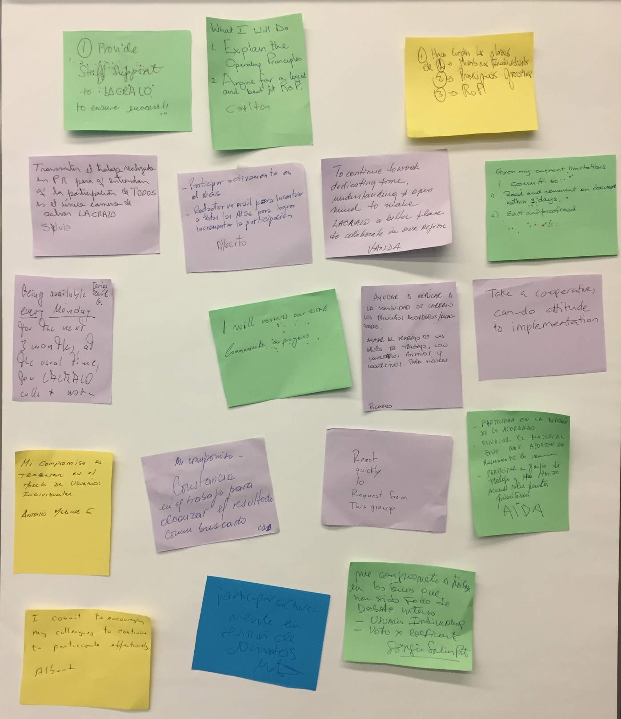
Our Commitments to Each Other
Zoom in and read them!

Slide 22
KEYPAD POLLING RESULTS

Slide 23
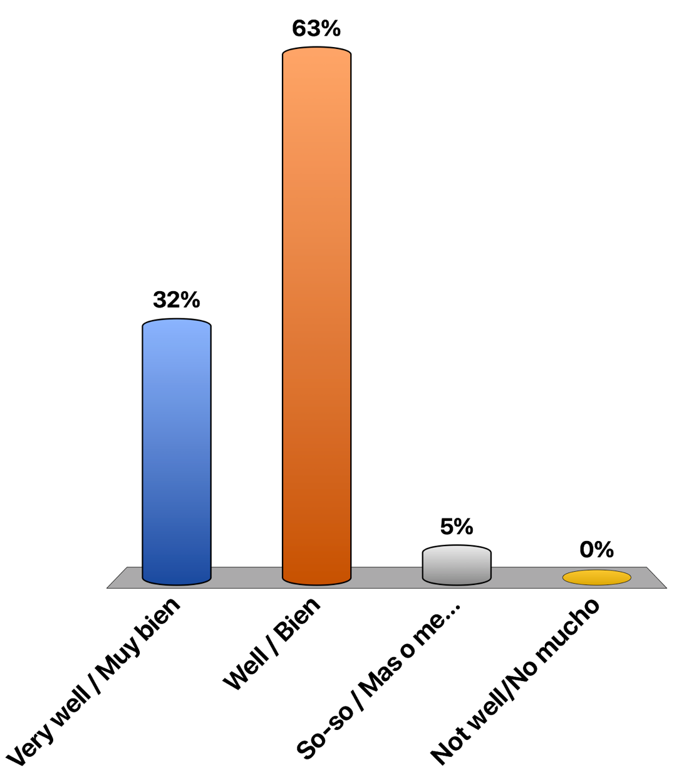
How well does this Common Purpose statement represent my views?
Very well / Muy bien
Well / Bien
So-so / Mas o menos
Not well/No mucho
This vote was a mistake, she misunderstood the question

Slide 24
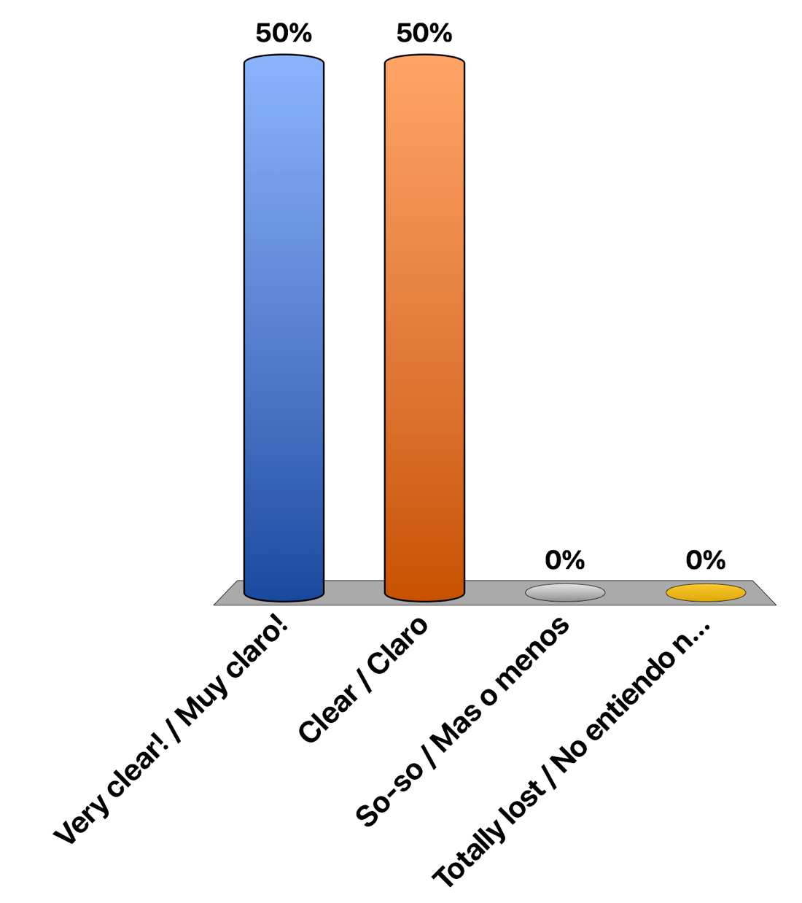
I’m clear about what we have agreed to in this meeting?
¿Tengo claridad sobre lo que acordamos en esta reunion?
Very clear! / Muy claro!
Clear / Claro
So-so / Mas o menos
Totally lost / No entiendo nada

Slide 25
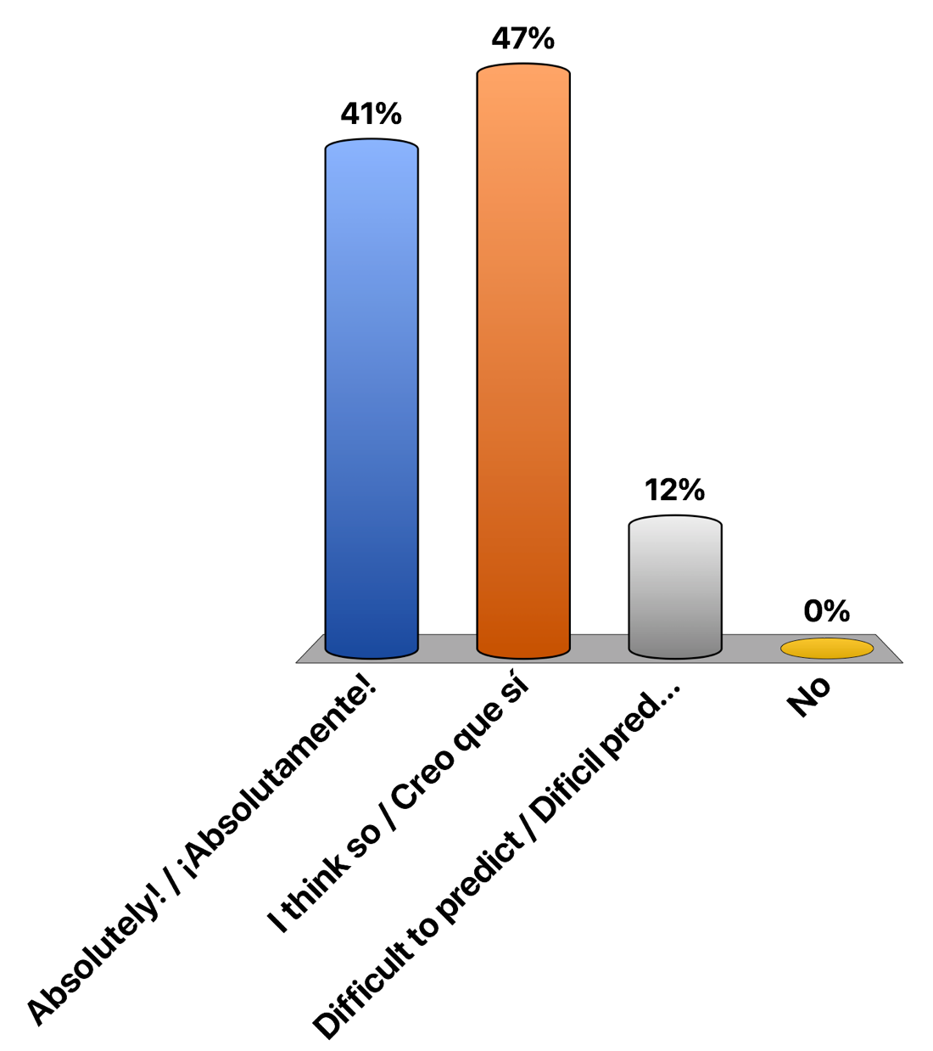
Will we be able to complete this work after the meeting?
¿Seramos capaces de terminar este trabajo después de la reunion?
Absolutely! / ¡Absolutamente!
I think so / Creo que sí
Difficult to predict / Dificil predecir
No

Slide 26
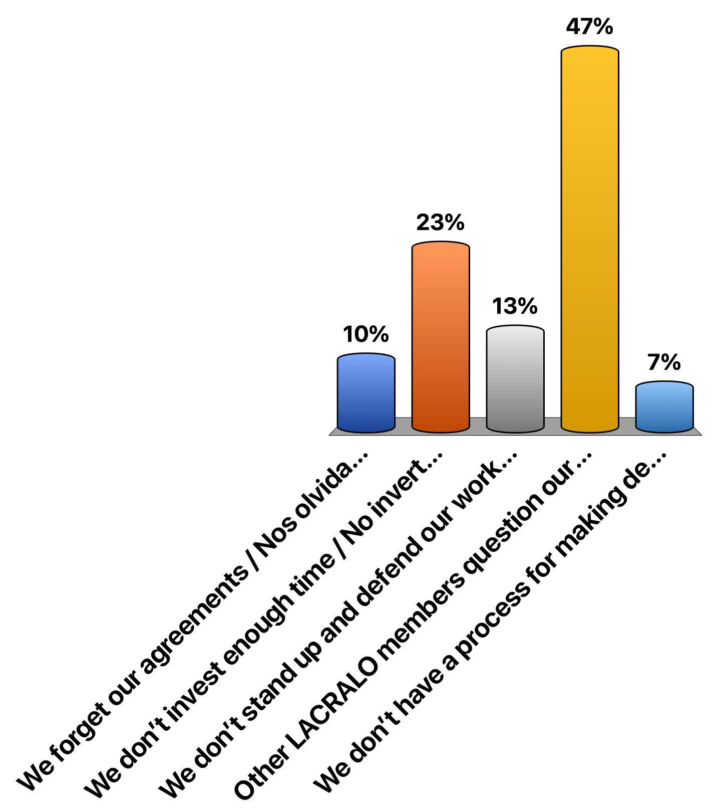
What will be our biggest challenges to finishing this work after the meeting?
Cuáles serán nuestros desafíos principales para poder terminar este trabajo después de esta reunión? CHOOSE TWO OPTIONS!!!!!
We forget our agreements / Nos olvidamos de nuestros acuerdos
We don’t invest enough time / No invertimos suficientamente tiempo
We don’t stand up and defend our work together / No defendemos suficientamente nuestro trabajo juntos
Other LACRALO members question our results, re-opening issues / Otros integrantes de la LACRALO cuestiona nuestros resultas, re-abriendo los temas
We don’t have a process for making decisions / No tenemos un proceso para tomar decisiones

Slide 27
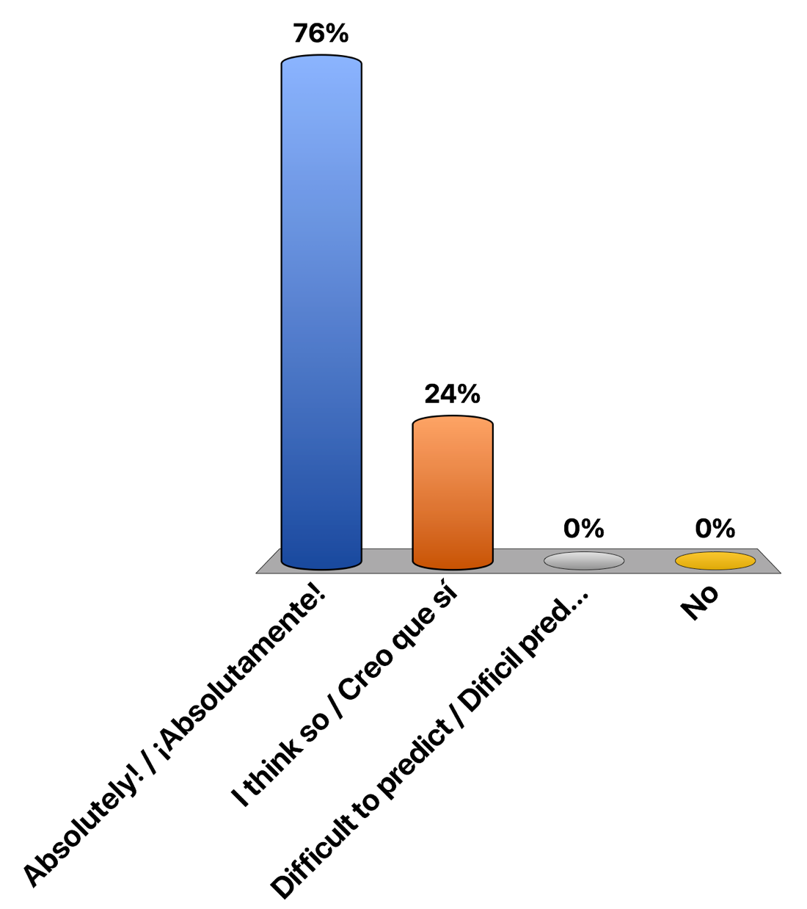
Will our work this week make a difference in LACRALO?
Tendrá un impacto positivo en LACRALO nuestro trabajo esta semana?
Absolutely! / ¡Absolutamente!
I think so / Creo que sí
Difficult to predict / Dificil predecir
No

Slide 28
Participants
LACRALO MEMBERS
Sergio Salinas
Vanda Scartezini
Sylvia Herlein
Alberto Soto,
Carlos Aguirre
Carlton Samuels,
Bartlett Morgan
Lance Hinds
Jacqueline Morris,
Jason Hynds (Fellow).
Ricardo Homquist
Maritza Aguero
Humberto Carrasco
Aida Noblía
Antonio Medina
ICANN STAFF
Albert Daniels
Heidi Ullrich
Rodrigo de la Parra
Silvia Vivanco
Susie Johnson
Claudia Ruiz
MEDIATION TEAM
David Plumb
OBSERVER (only for some periods)
Carlos Raul Gutiérrez

