Slide 1
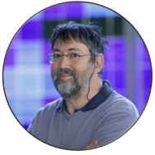
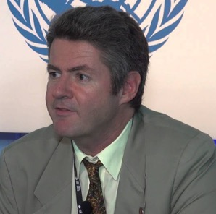
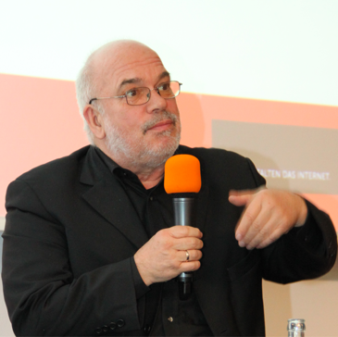
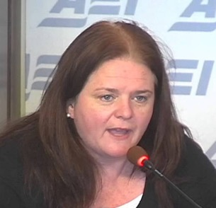
Monthly RoundTable 3 (by EURALO)
Olivier Crépin-Leblond
Sébastien Bachollet
Máté Mester
Wolfgang Kleinwachter
Tuesday 16 March 2021 - 19:00-20:30 UTC
Welcome
Next steps
Summary
Introduction & scoping Q
Q&A session
Internet Governance Outlook 2021
Digital Cacophony in a Splintering Cyberspace
Fiona Alexander
Richard Hill
Lucien Castex
Internet Governance EUROPE vs the rest of the World
Panellists

