Slide 1
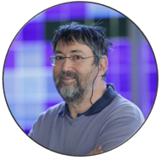
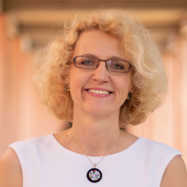
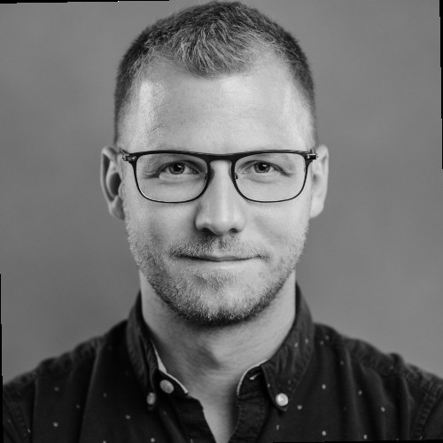
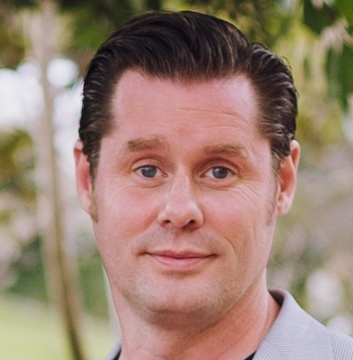
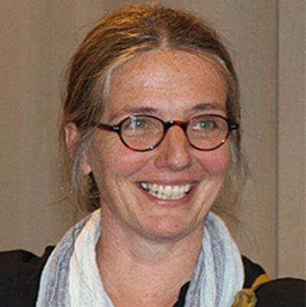
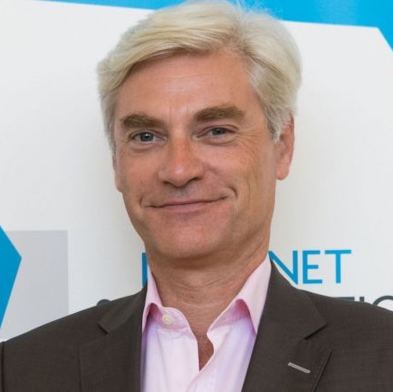
Monthly RoundTable 2 (by EURALO)
“Internet & Jurisdiction: Domain Names issues
Sébastien Bachollet
Joanna Kulesza
Máté Mester
EURALO
Tuesday 23 February 2021 - 19:00-20:30 UTC
Welcome
Next steps
Introduction & scoping Q
Q&A session
Summary
Uta Kohl
Bertrand de la Chapelle
Dan B. Svantesson
Jurisdiction and public international law
"Action at the DNS level to address abuses:
is it appropriate?"
ICANN jurisdiction and private international law
Internet governance by contract?

