Slide 1



Slide 2
ICANN Stakeholder Journey
Update Report | March 2016 | Christopher Mondini

Slide 3
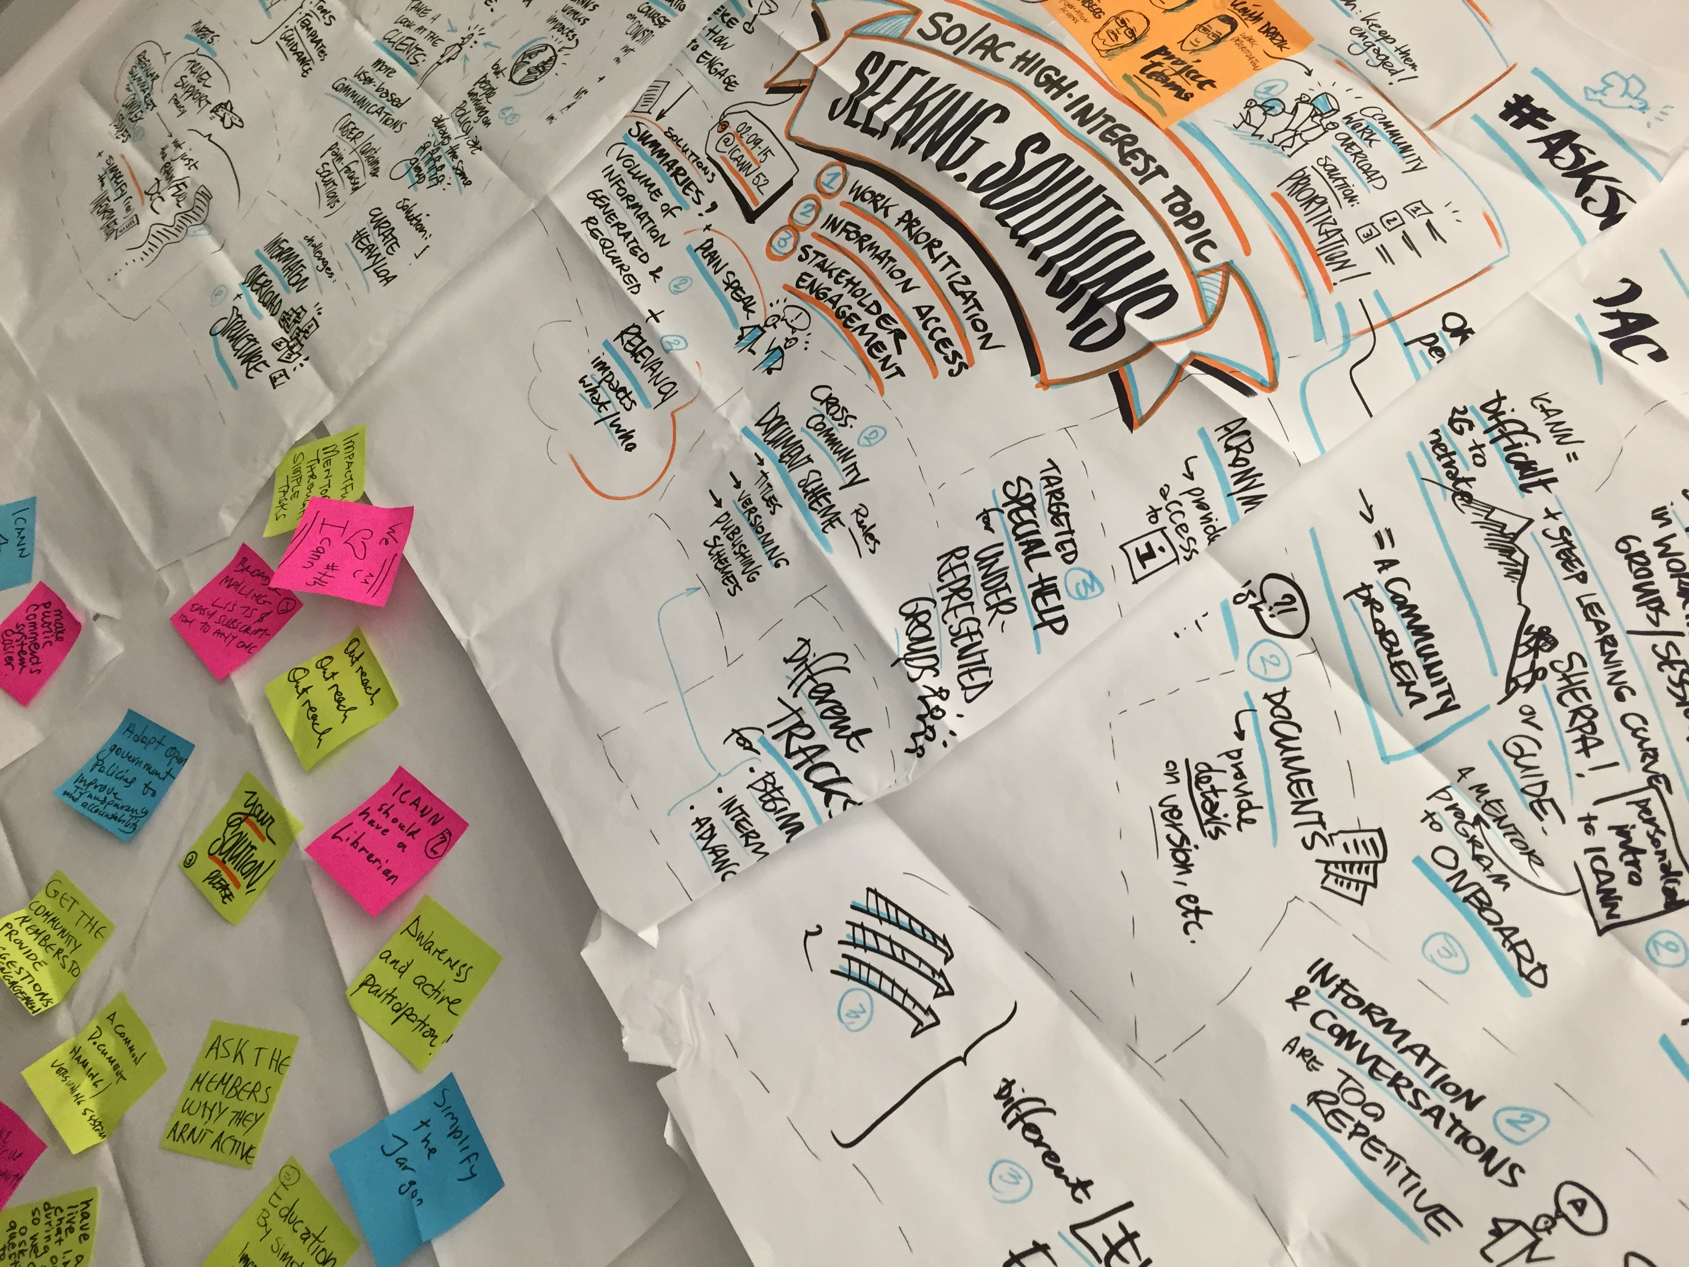
Question:
How can ICANN get more volunteers to
be more meaningfully involved?
Notes:
This is our problem statement

Slide 4
The Stakeholder Journey
Background
Notes:
“Stakeholder Journey” is a conceptual framework we are using to organize current and potential work to address our problem statement.

Slide 5

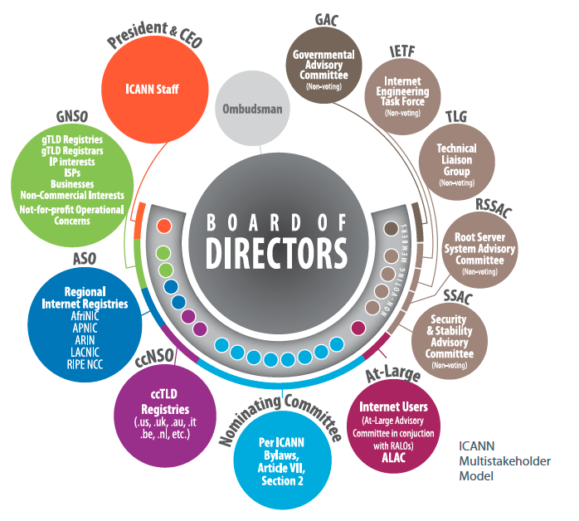
Origins of this project
1
2
3
SO/AC Leaders’ Request at ICANN51
Los Angeles
Desire to Refine and Operationalize the Engagement Model
Observations of Successes and Barriers Encountered

Slide 6

Wikipedia: “The Newcomer Rejection Effect”
After reaching its peak in 2007, the size of the Wikipedia community has been shrinking.
The newcomer rejection effect: once a community grows large and complex enough to need established rules and norms, well-meaning and qualified newcomers are rejected because they don’t understand these norms. Newcomers have the knowledge, but don’t know that culture.
Wikipedia has changed from “ the encyclopedia that anyone can edit” to the encyclopedia that anyone who understands the norms, socialized him or herself, dodges the impersonal wall of semi-automated rejection and still wants to contribute his or her time and energy can edit
This is a common symptom of open collaboration systems.
Source: “The Rise and Decline of an Open Collaboration System: How Wikipedia’s
reaction to popularity is causing its decline.”
Notes:
There is another common pitfall of open, collaborative communities.
That their norms and culture represent an unintended barrier for newcomers to participate.

Slide 7
The Stakeholder Journey
Current State
Notes:
Breakup your presentation, divide it into sections. This is especially useful if most of your presentation is text.

Slide 8
ICANN Engagement - Progress to Date
Many new followers and audiences, but how many new active participants?
Successes
Growth in audiences, social media, downloads, courses taken, meeting registrations, MOUs, etc.
More company, government and organization doors are open to ICANN
More vocal supporters in public forums (incl. intergovernmental meetings)
Greater awareness of role and “brand”
But…
Continuing challenge of formulating ICANN’s “asks” to interested parties
Lack of easy “on-ramps” to convert interest to participation
“With earlier, urgent goals of defending and securing support for ICANN largely met, it is important now to focus on future sustainability and policy output goals”
Notes:
ICANN has worked hard to build awareness and grow the population of defenders and advocates for the multi stakeholder model.
But this has not translated into more participation in the policy making work of ICANN>

Slide 9
Summary of Pain Points
Complexity
Time and expense
Language and connectivity
Knowledge requirements
Intimidating incumbents
Notes:
In summary, here are some of the pain points that must be addressed to make progress on our problem statement.

Slide 10
Tools, Culture and Structure – Categorizing “fixes”
There is no shortage of ideas – Most fall into one of these three categories:
Behavior and Culture
Tools and Platforms
Succession Planning Future Leader Development  Alumni Programs  Remote Participant Promotion  Emphasis on non-travel related benefits  Sanctions for Non-Contributing Volunteers  Work Requirements to Reach Next Level  Published Skills Requirements
Mentorship Platform 
ICANN.org profiles as Passports 
Graduated Learning Paths  How To Guides  Member Management Tools  SO/AC Outreach Toolkits Enhanced Interpretation/Translation  Subject Matter Salons
Structural Issues
Onboarding Linked to SO/AC Talent Needs  Outreach POC for each Structure (to form a Caucus)  Declared Area of Interest from Newcomers  “Sustaining” Category for Non-Active Volunteers  Term Limits or Travel Support Gaps  More a la carte Ways to Participate (shorter term or less time commitment)
All Categories Must Be Addressed Together – But Need to Prioritize Efforts
Notes:
Brainstorming on these issues leads to a lot of proposals for “fixes” and they are all great ideas. Yet, in isolation, the fixes won’t work. They need to be part of an overall push on multiple fronts:
Tools and Platforms – ICANN staff can work on these
Behavior and Culture – Staff and Community must collaborate here
Structural Issues – Roles for both staff and community.

Slide 11
The Stakeholder Journey
Recommendations
Notes:
Breakup your presentation, divide it into sections. This is especially useful if most of your presentation is text.

Slide 12
Recommendations
1. Continue existing support for SO/AC outreach efforts
2. Attract volunteer talent by topic, not ICANN structure
3. Facilitate Working Group and PdP participation
4. Develop ways to “activate” passive followers
5. Actively cultivate and develop future leaders
6. Use data to track journeys and measure progress
Notes:
Based on review of the information at hand, members of the joint Policy and Engagement staff team made six recommendations.

Slide 13
Stakeholder Journey
Mapping and Measuring
Notes:
Breakup your presentation, divide it into sections. This is especially useful if most of your presentation is text.

Slide 14
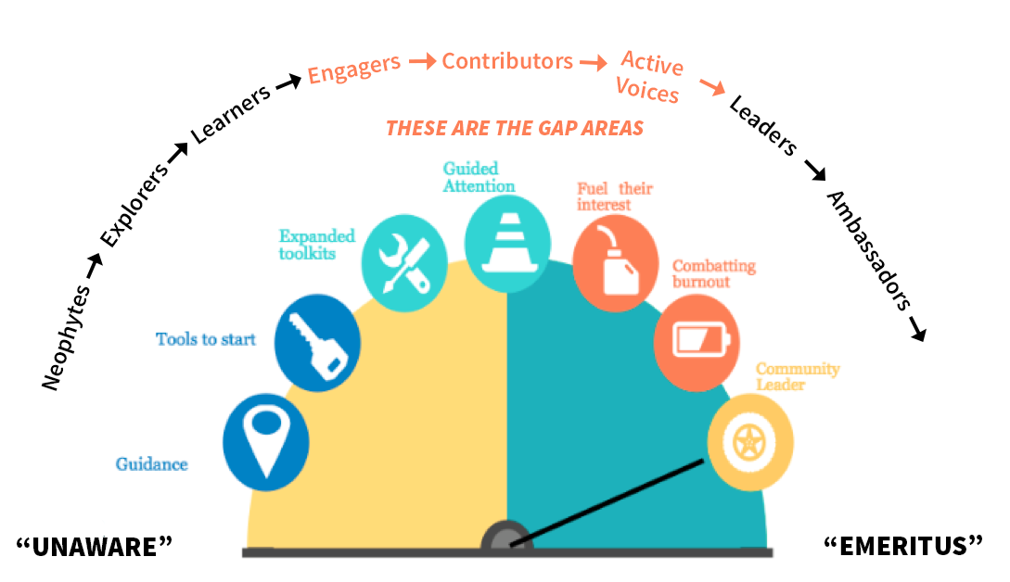
A Complete Stakeholder Lifecycle
Many distinct and complete journeys exist within a lifecycle; identifying stages of the journey informs what each stakeholder needs from the organization
Notes:
ICANN excels in attracting newcomer, fellowship and NextGen talent. ICANN also has committed leaders and experts in its volunteer community. The gap is how a stakeholder gains experience and finds a fulfilling, productive path to deeper involvement.

Slide 15
Summary and a Way Forward
Notes:
Breakup your presentation, divide it into sections. This is especially useful if most of your presentation is text.

Slide 16
Summary of Key Points
Engagement to-date has largely focused on awareness / support
Go to market by issue; community and staff together where possible
1
4
Cultural and structural barriers inhibit active policy participation
A shift from “outreach” to policymaker “recruitment”
focus = requires resource
2
5
Community development
& customer journey
disciplines can help
Confirm stakeholder
journey stages; define metrics and track results
3
6
Notes:
This is a summary of the main points.

Slide 17
Work in Progress
Plain Language Issues Matrix
Mentorship Program (DPRD)
Working Group Web Page (Web Team)
SO/AC Structures Web Page (Web Team)
Membership Management Software (Web Team)
‘How to’ Guides (e.g. Build Your Skills at ICANN) (DPRD)
ICANN.org profile functionality (Web Team)
Develop Review Panel Enthusiasts (Strategy)
_
Notes:
Some examples of Work in Progress appear here.

Slide 18
Questions / Discussion
Notes:
Breakup your presentation, divide it into sections. This is especially useful if most of your presentation is text.

Slide 19
Africa Engagement

Slide 20
Key Initiatives – Africa Region
INITIATIVE | COMMITMENTS | DELIVERY
Africa Regional Strategy | Develop a framework for ICANN's Africa strategy Support stronger presence for ICANN in Africa Increase Africa's participation in ICANN Support the DNS & Internet Industry in Africa | Strategy document 2016-2020 DNSSEC Roadshow (14 countries visited :more than 75 tech. and managers trained and 5 countries zone files signed) DNS Entrepreneurship workshops (8 countries covered) DNS Business Exchange Program (2 interns@IP Mirror, 2 Interns @Afilias, 6 ccTLDS @ATI Tunisia)
Africa Engagement Centre | Evolve and further globalize ICANN have an ICANN footprint in Africa Deepen ICANN Engagement in Africa | Office space lease agreement signed on 29 February 2016 Ongoing registration process undergoing as a branch Operational from April 1st 2016
DNS Entrepreneurship Centre | DNS-EC to serve as a repository for DNS knowledge and expertise ICANN through partnerships with regional and international experts provides training and mentoring programs | Agreement signed between ICANN and Egypt’s NTRA at ICANN 50 meeting in 2014 9 workshops / 5 countries 150+ trainees / 15 countries

Slide 21

We are opening our office in Africa (Nairobi, Kenya)!

Slide 22
Key Roles of this Office
This will be the Main Engagement Centre for Africa
  Possibility of other satellite Offices / Centers in other regions in Africa (North Africa, Southern Africa or Western Africa)
  The Office will serve the whole of Africa
This office will serve as ICANN’s foot hold and provide our physical presence in Africa
Support the 3 ICANN Africa staff especially as an Institutional Engagement focal point with AF*, Governments and I* organizations in the continent
Further, the activities of the Main Engagement Centre will be defined and managed by GSE Africa.

Slide 23
Significant Gains Realized in Capacity Building in Africa
1
Overall Improved Visibility for ICANN in the region
2
DNS Business Exchange Program (Interns to IP Mirror, AFILIAS and .TN)
3
Concept of the DNS forum and DNS Awards ( 4th edition at ICANN 55)
4
Multiple communication channels with Community (Lists, webinars…)
5
Topical Workshops ( Focusing on emerging issues like IP & Trademarks)
6
Additional L-Root copies deployed (Tanzania, Mauritius, Seychelles… )
7
Over 14 DNSSEC Roadshows (.TZ, .KE, .ZM, .MA, .BW signed as a result)
8
Over 8 additions to GAC reps
9
DNS Entrepreneurship: Over 300 Registrars/Registries from 6 Countries trained on DNS Marketing

Slide 24
ICANN Readout Sessions
Jia-Rong LOW | VP GSE and MD for APAC Hub
GSE – At-Large Meeting

Slide 25
ICANN Readout Sessions – the APAC story
WHAT
Community readouts
Community-driven “de-brief”: Planned, organized and hosted by community
Highly localized, conducted in local language
Topics determined by the community
Duration and timing
WHEN
Held after each ICANN meeting
Each session lasting 3-4 hours
WHO
People involved
Organized by “key” stakeholders, attendees of ICANN meetings
Attended by 30-40 participants
Sponsorship / Support
How
No sponsorship from ICANN, although ICANN supports through participation as speaker and providing materials where relevant
Venue at organizers’ HQ/in-kind from supporters
Notes:
Look for different ways to display your data or text by using alternatives to simple bullets.
To adjust the number in the arrow to text or another number, click on the text box around the number, revise.
To add an arrow, click on the arrow, ensure the arrow is highlighted, COPY and PASTE and move to the desired placement, or DELETE if there are too many arrows.

Slide 26
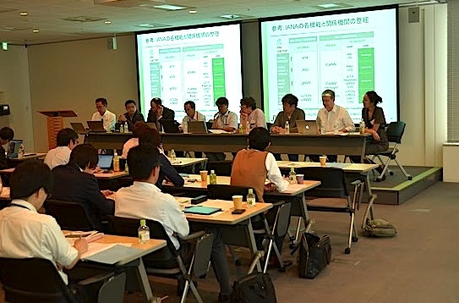
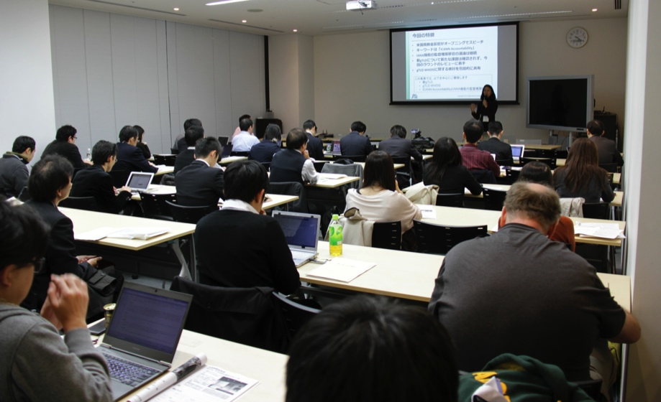
Case Study 1: Japan Readout Session
Readout began in 2001 (45 sessions to date, after every ICANN meeting since), organized by JPNIC and IAJapan
Typically attended by 30-40, including DNS industry, business, technical, civil society, government stakeholders. Public event with remote participation.
Different topics/tracks covered by the relevant representatives, including reports on GAC, ccNSO, RSSAC, new gTLD, and IANA transition.
Key challenge: Sustaining interest and attracting more diverse participants. Organizers looking into ways to revamp the readouts, such as providing more targeted content related to businesses.
Notes:
Different topics/tracks covered by the relevant representative i.e. GAC update (done by GAC rep); ccNSO update by member of ccNSO (JPRS), new gTLD development and updates (by brands etc), IANA transition (by JPNIC, represented by Okutani who is CRISP chair), ALAC statements (by ISOC JP chapter), etc
APAC Hub invited to give updates on APAC activities and take part in panel discussion
Observations: While this has traditionally been driven by community, the organizers are asking ICANN to co-host this and to look into ways to revamp the program – to attract more participants and to sustain interest, as the readout is In the advanced stage of its lifecycle (readout is into the 45th edition). We will be looking into ways to enhance the readout and attract fresh crowd. We’ll support the readouts more closely, and at the same time, not

Slide 27
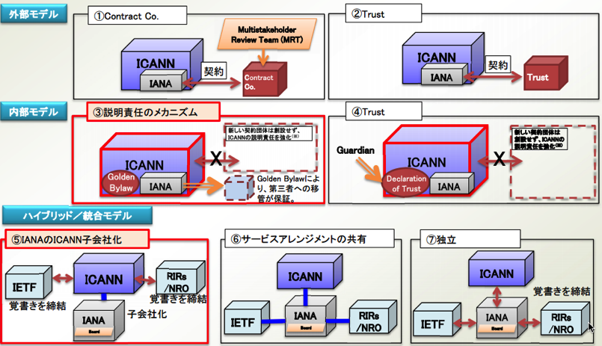
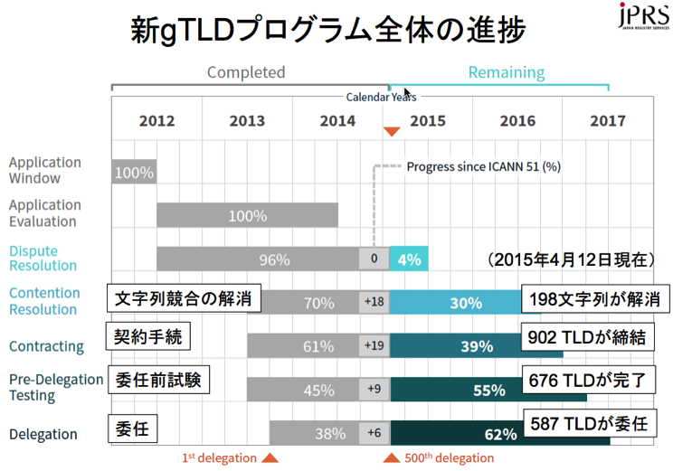
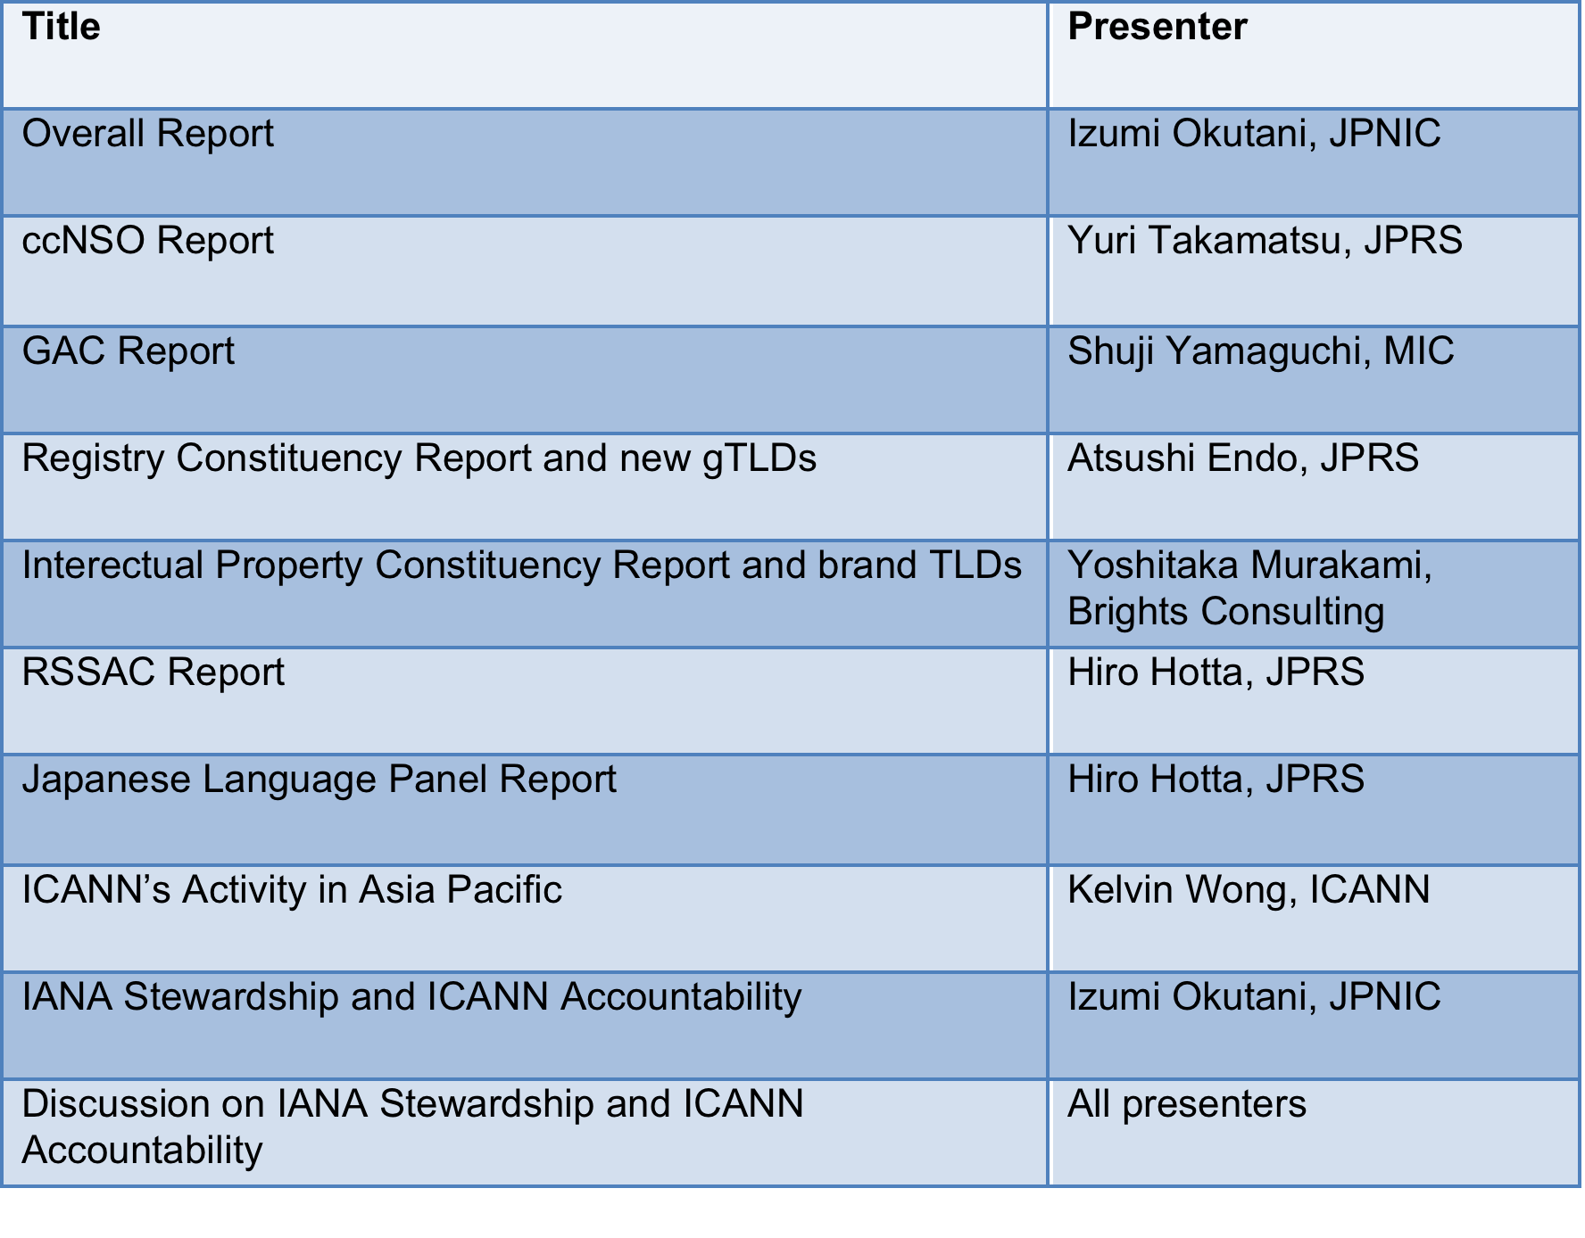
Agenda in Readouts
Below is an actual agenda from a Japan readout session held in April 2015, after ICANN52
Materials for each meeting, including presentation slides,
and recordings can be found here:
https://www.nic.ad.jp/ja/materials/icann-report/ (Japanese)

Slide 28
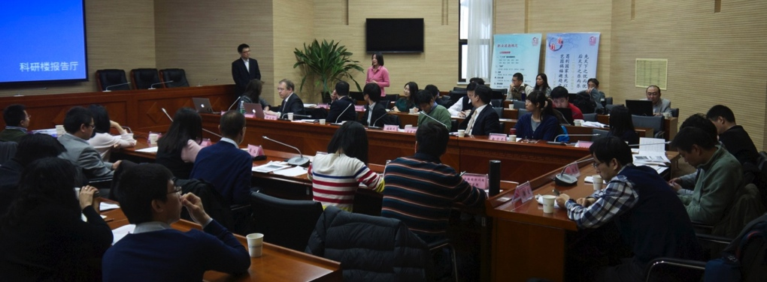
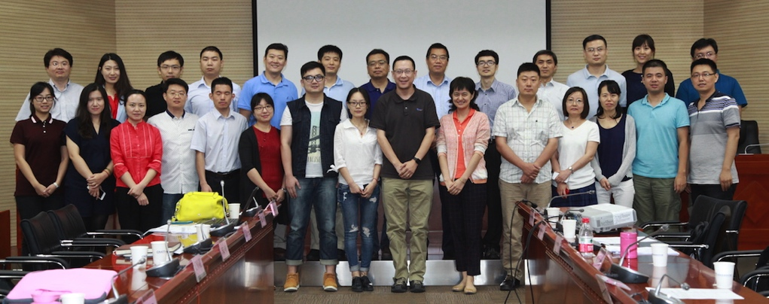
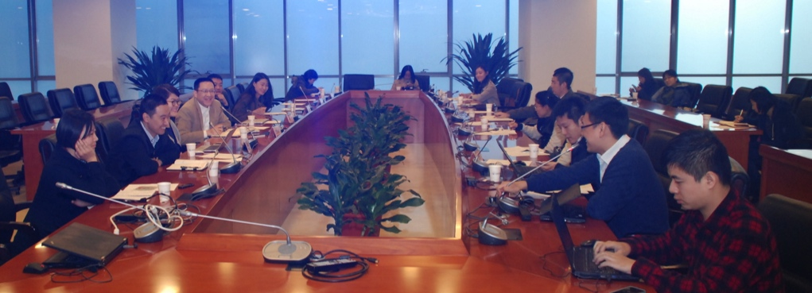
Case Study 2: China Readout Sessions
Originally a closed meeting for Govt debrief, by Chinese Govt agencies
After MoU with CAICT, ICANN Beijing Office began co-hosting with CAICT, and this became a more inclusive meeting (since ICANN50)
Typically attended by 30-40, including DNS industry, government, business, technical, academia, researchers.
Agenda is similar to the Japanese version
Observations: Chinese Govt is realizing that the readout is a better way to engage other stakeholders. This has also been generally well received. But it is still currently not a completely public event – attendance is by invitation only, though stakeholders involved in ICANN work are generally invited.
Notes:
Readouts originally started out as internal briefing and de-briefing sessions conducted by the Chinese Govt agency (MIIT, CNNIC, and Chinese Academy of ICT, CAICT). This was closed to other stakeholders.
Format: With the MOU signed between CAICT and ICANN since the establishment of APAC Hub, ICANN Beijing Office began co-hosting with CAICT, and this was converted to become a more inclusive meeting.
5 readouts has been conducted since (ICANN50-54). Typically attended by 30-40, including DNS industry, government, business, technical, academia, researchers.
Agenda: Agenda is similar to the Japanese version, although in the Chinese version, agenda is co-created between ICANN and community.
Observations: With these readouts, Chinese Govt is realizing that it is a better way to involve and engage other stakeholders. This has also been generally well received. Nonetheless, it is still currently not a completely public event – attendance is by invitation only, though stakeholders involved in ICANN work are generally invited.

Slide 29

Collaboration with APRALO/ALSes on readouts in regional platform
Sharing best practice (readout sessions)
APAC Hub is trying to secure session during APrIGF 2016 to share best practice
“For the community, by the community: Towards a sustainable model for community outreach (ICANN readout sessions by the Community)”
Designed to both conduct an actual ICANN readout to APrIGF attendees, AND to share best practices on readouts
Leveraging APRALOs/ALSes on ICANN readouts
APAC GSE worked with APRALO to submit proposal for APrIGF2016
Good example of collaboration with RALO/ALS and how RALO/ALS can support regional GSE
If given the opportunity to run this session, this can a good model for use by other regions
Notes:
Icons or text are editable, change/add to your preference.

Slide 30
Thank you!

