Slide 1
ICANN Draft Five-Year Operating Plan & FY16 Operating Plan and Budget Calendar
25 November 2014

Slide 2
Agenda
Overview of the Five-Year Operating Plan Version 1 (FY2016-FY2020)
FY16 Operating Plan and Budget – Calendar
Next Steps

Slide 3
Introduction
Notes:
ICANN has drafted a multi-year planning framework based on input from the ICANN community during the development of the Strategic Plan.
The framework includes the following three elements:
Strategic Plan - Developed with community input, to be updated every five years, and includes vision & mission, strategic objectives, goals, key success factors, and strategic risks.
Five-Year Operating Plan – Developed with community input and to be updated annually to include: five-year planning calendar, strategic goals with corresponding key performance indicators, dependencies, five-year phasing, and list of portfolios; and five-year financial model.
Annual Operating Plan and Budget – To be derived based on the Five-Year Operating Plan and community input annually, and will include: Portfolios with corresponding key performance indicators, risks, dependencies, activities, budget, and projects.

Slide 4
Review Five-Year Operating Plan
Public Comment Open until 5 January 2015: https://www.icann.org/public-comments/proposed-opplan-budget-2016-2020-2014-11-11-en

Slide 5
Questions & Answers

Slide 7
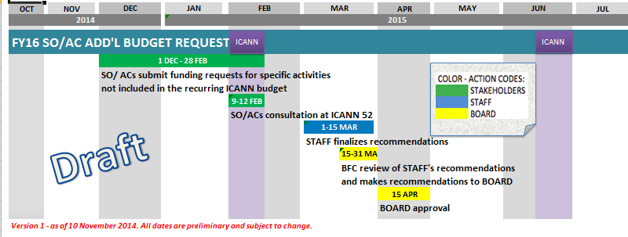
SO/AC Budget Request Calendar

Slide 8
FY16 Operating Plan and Budget – Community consultation around ICANN 52
Objective:
Communicate between Staff and Stakeholders on significant budget assumptions at the beginning of the Budget process.
Suggested timing: ICANN52 – Singapore
Half a day?
Should it be at a different time than ICANN52?
Suggested Format: face-to-face working session
Small group to be able to interact and work,
Group needs to be representing Staff and Stakeholders

Slide 9
Questions & Answers

Slide 10
Next Steps
Draft Five-Year Operating Plan Public Comment closing date – 5 January 2015
Face-to-face meetings at ICANN 52 Meeting in Singapore – February 2015
summary of Public Comments received
review main assumptions underlying the FY16 budget
Submit Five-Year Operating Plan for Board Approval – March 2015
Open Public Comment on Draft FY16 Operating Plan and Budget – March 2015

